Slide 1

Exploring SAP Data Warehouse Cloud from A to Z
ANA364
Ingo Hilgefort, SAP

Slide 2
Disclaimer
The information in this presentation is confidential and proprietary to SAP and may not be disclosed without the permission of SAP. Except for your obligation to protect confidential information, this presentation is not subject to your license agreement or any other service or subscription agreement with SAP. SAP has no obligation to pursue any course of business outlined in this presentation or any related document, or to develop or release any functionality mentioned therein.
This presentation, or any related document and SAP's strategy and possible future developments, products and or platforms directions and functionality are all subject to change and may be changed by SAP at any time for any reason without notice. The information in this presentation is not a commitment, promise or legal obligation to deliver any material, code or functionality. This presentation is provided without a warranty of any kind, either express or implied, including but not limited to, the implied warranties of merchantability, fitness for a particular purpose, or non-infringement. This presentation is for informational purposes and may not be incorporated into a contract. SAP assumes no responsibility for errors or omissions in this presentation, except if such damages were caused by SAP’s intentional or gross negligence.
All forward-looking statements are subject to various risks and uncertainties that could cause actual results to differ materially from expectations. Readers are cautioned not to place undue reliance on these forward-looking statements, which speak only as of their dates, and they should not be relied upon in making purchasing decisions.

Slide 3


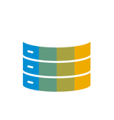


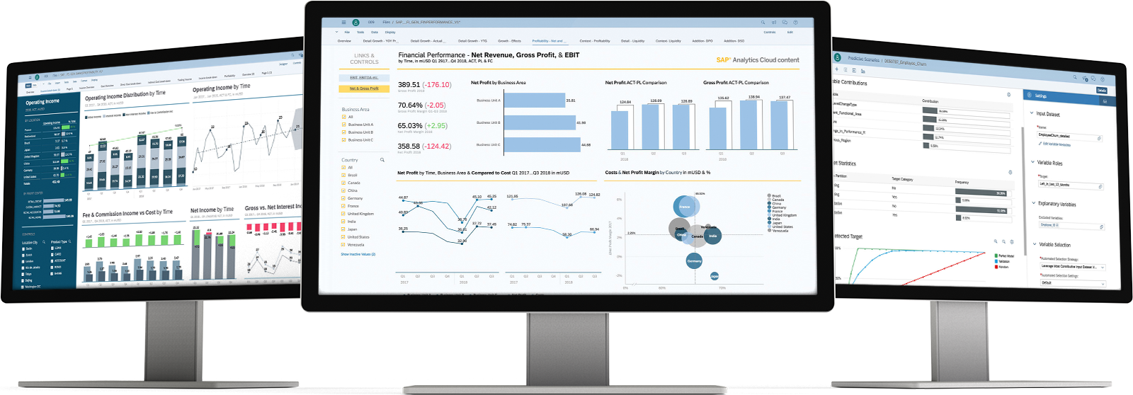
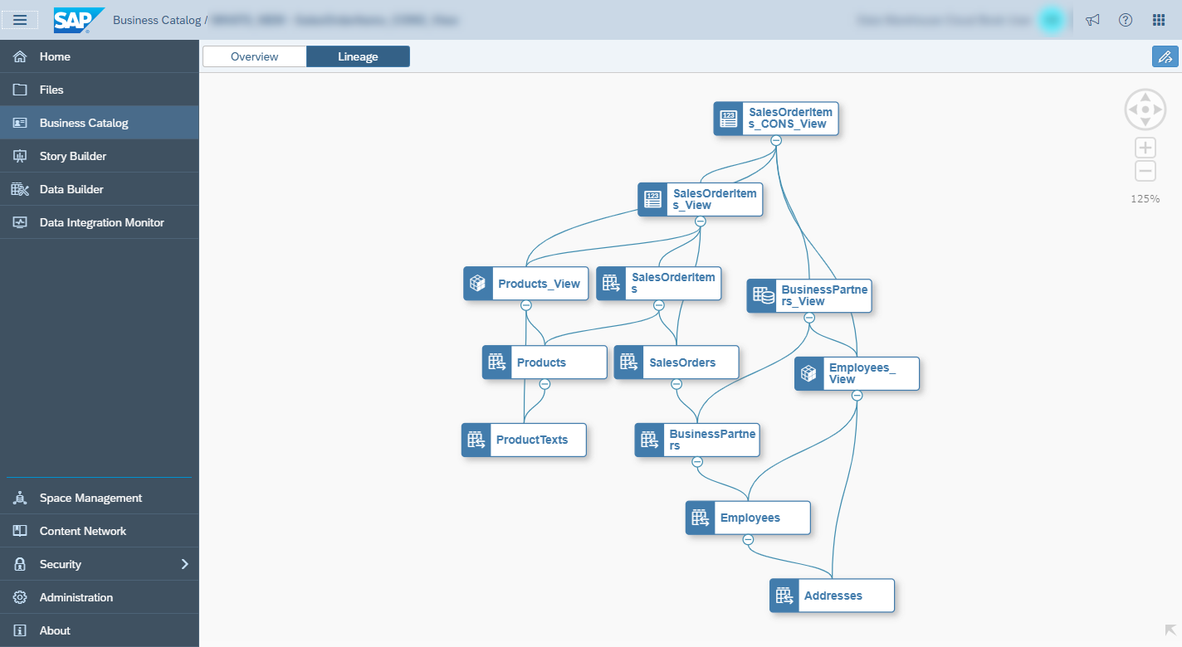




SAP Data Warehouse Cloud
“SAP Data Warehouse Cloud is the strategic public cloud product for all data warehouse scenarios in the cloud.”
Self-Service Data Modeling & Analytics
Enabling Data Democratization
End-to-End Data Warehousing

Slide 4

SAP Data Warehouse Cloud Use Cases
Empower business users with self-service, top-down driven analytics in an IT governed environment via spaces. Instant access to business applications via pre-built adapters to integrate any type of data from any source, SAP and non-SAP data sources, on-prem and in the cloud.
Self-Service Data Modeling & Analytics
Accelerate time-to-insight via rapid onboarding of resources. Lower adoption barrier with a business semantic layer abstracting data layer from underlying physical data sources. Leverage data catalog and pre-built business content (industry-data models, KPIs) and deliver enterprise-wide collaboration via space concept to support end-to-end decision-making.
Enabling Data Democratization
Leverage existing SQL skills, SAPIDEs, open-source and/or in-built tooling for data integration, governance, harmonization and Big Data historization to provide a consolidated view across the enterprise. Extract maximum investment from existing on-prem investments via hybrid scenarios e.g. SAP HANA for SQL DW, SAP S/4HANA, SAP BW/4HANA etc.
End-to-End Data Warehousing

Slide 5




SAP Data Warehousing Statement of Direction
SAP continues to innovate industry-leading data warehousing technologies to enable the Intelligent Enterprise.
SAP Data Warehouse Cloud is a new offering for data warehousing in the public cloud – it can be a stand-alone solution or complement the data warehouse portfolio of SAP. Neither will it replace SAP BW/4HANA nor SAP HANA for SQL data warehousing.
SAP HANA FOR SQL DATA WAREHOUSING
SAP BW/4HANA
SAP DATA WAREHOUSE CLOUD
SAP HANA
ANYPREMISES
SAP BW/4HANA and SAP HANA for SQL data warehousing are the strategic solutions for on-premises and private cloud data warehousing.
HYBRID
SAP Data Warehouse Cloud extends your existing data warehousing investment to support hybrid cloud.
PUBLIC CLOUD
SAP Data Warehouse Cloud is the strategic public cloud product offered as a software service managed by SAP.

Slide 6
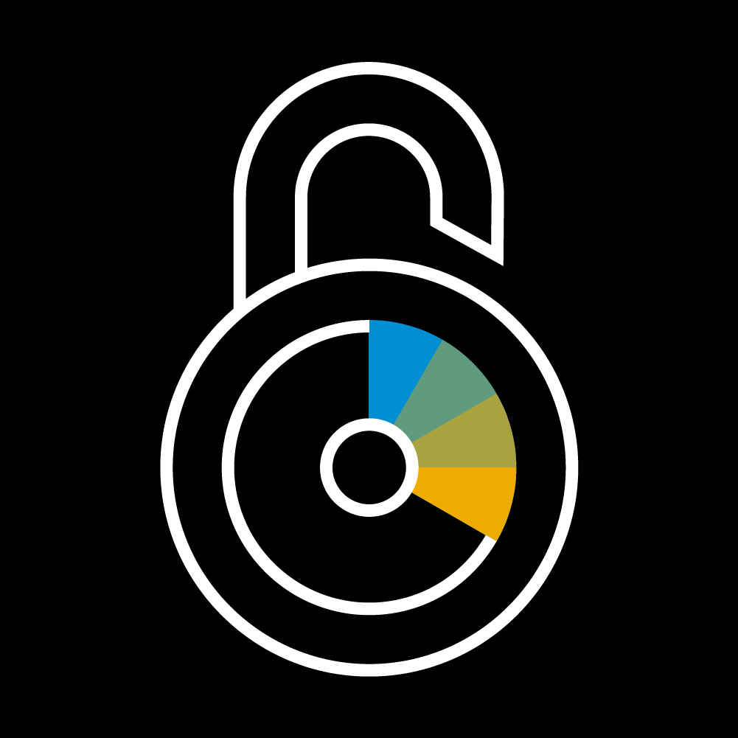
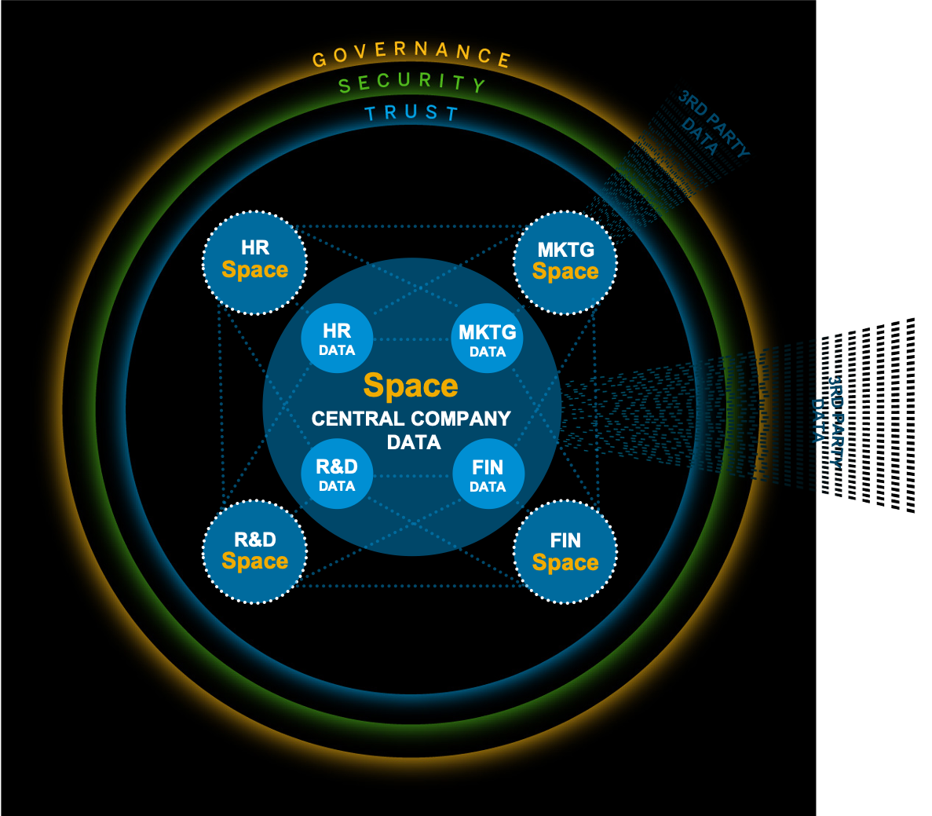
Governance Services: Space Management
Governance Services
Data Sources & Ingestion
Repository Services
Data Modeling Services
Business Modeling Service
Security Services
Consumption & Business Content
Metadata object isolation​
Compute and storage elasticity
Resource isolation
Cost control*
Pay-per-use*
Transparent monitoring & statistics
Space permissions
Open SQL Schemas
Space Schema User
Time Dimension
HDI-Container
SAP HANA Data Lake Integration

Slide 7

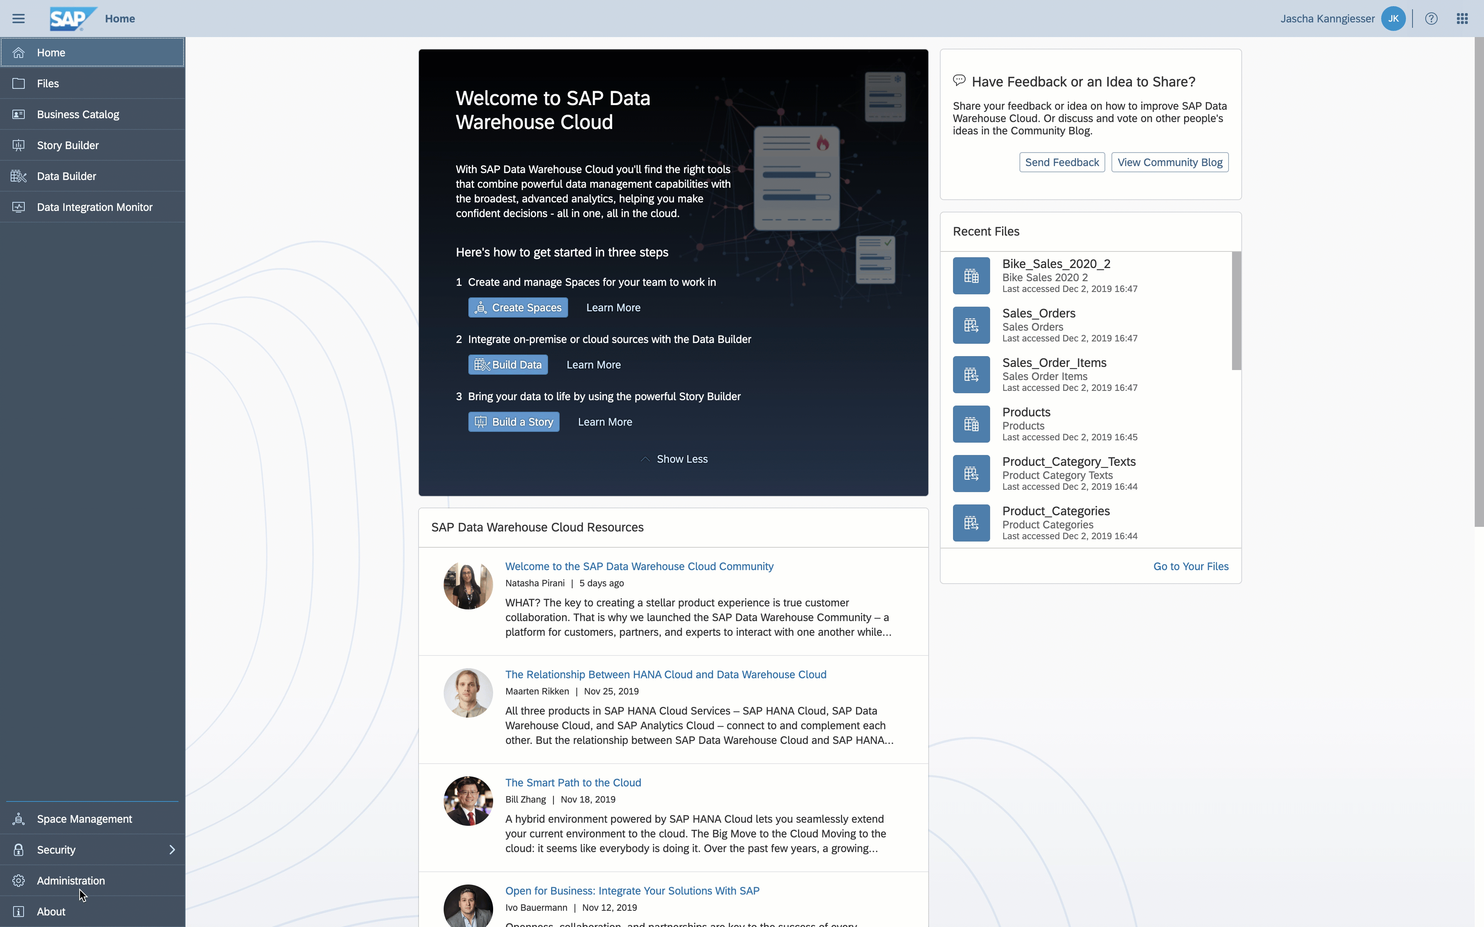
Governance Services: Administration
Governance Services
Data Sources & Ingestion
Repository Services
Data Modeling Services
Business Modeling Service
Security Services
Consumption & Business Content
Add, edit, and remove Data Provisioning agents
IP Whitelisting
Auditing

Slide 8

Data Sources & Ingestion – Overview
Governance Services
Data Sources & Ingestion
Repository Services
Data Modeling Services
Business Modeling Service
Security Services
Consumption & Business Content
Remote source replication
Virtual access to remote data
Local File Upload (CSV) with Data Wrangling
Open SQL Schema
Data Replication Monitor
Connections provide access to data from different systems. Based on SAP HANA Cloud technology data can be replicated or accessed virtually. The local file upload allows for easy-to-use data models from scratch.

Slide 9
Data Sources Overview
Governance Services
Data Sources & Ingestion
Repository Services
Data Modeling Services
Business Modeling Service
Security Services
Consumption & Business Content
Current
Q3 2020*
Q4 2020 & beyond*
Connection Tiles
New Connection Tiles
New Connection Tiles
SAP ABAP
SAP HANA
Generic OData
SAP HANA Cloud
SAP Data Warehouse Cloud
SAP HANA Data Lake
SAP Sybase IQ
SAP IBP
Microsoft SQL Server
Oracle
Local CSV File
SAP Fieldglass
SAP S/4HANA Cloud
SAP BW/4HANA Model Transfer
SAP BPC
SAP BW
Generic Cloud Data Integration
Adverity
SAP ECC
SAP Marketing Cloud
Generic JDBC
SAP BW Query Snapshot
SAP Open Connectors
SAP S/4HANA
SAP SuccessFactors
Qualtrics
Dremio
SAP Source System Connectivity
Dynamo DB
PostgreSQL
SAP HANA 1.0
SAP HANA 2.0 HDI
SAP HANA Cloud
ABAP Extractors
ABAP CDS
ABAP DDIC Tables
New Connection Tiles as part of the Data Flow Beta Delivery*
New Connection Tiles as part of the Data Flow GA Delivery*
ABAP ODP
SAP BW
BW Query-as-a-Provider
Azure ADLS
Amazon S3
Google GCS
SFTP
Amazon Athena
BW InfoProvider
SAP BW/4HANA
HDFS
Amazon Redshift
MySQL
IBM DB2
Teradata
SAP S/4HANA Cloud
SAP Business One
Google BigQuery
Azure Synapse
SAP Data Warehouse Cloud
SAP SuccessFactors
openAPI
Azure Analysis Services
Partners
Azure SQL Database
APOS 150+ Sources
Snaplogic 500+ Sources
Informatica 140+ Sources
Adverity 400+ Sources
Datazeit
Precog
Delivered
Planned*
Partner
Notes:
Open Connectors only support the following types: CRM,DB,General,Marketing,Social

Slide 10
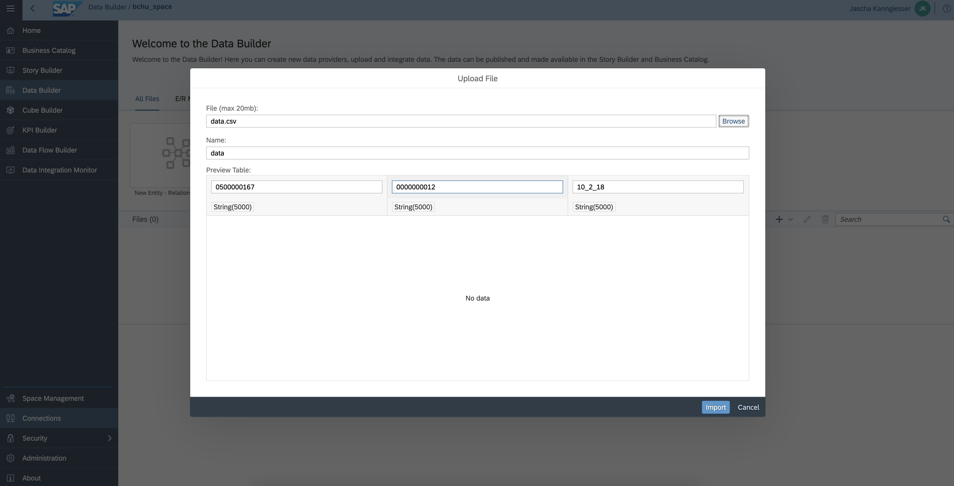
Data Sources & Ingestion: Local File Upload
Governance Services
Data Sources & Ingestion
Repository Services
Data Modeling Services
Business Modeling Service
Security Services
Consumption & Business Content
Local CSV file upload with data wrangling support
Apply various data wrangling and transformation rules, such as
Concatenate
Split
Extract
Replace
Change
Filter
Automatic creation of data models (tables) based on file structure
Columns derived from file structure
Data types identified based on existing data*
Consumption of uploaded data as tables in Data Builder

Slide 11
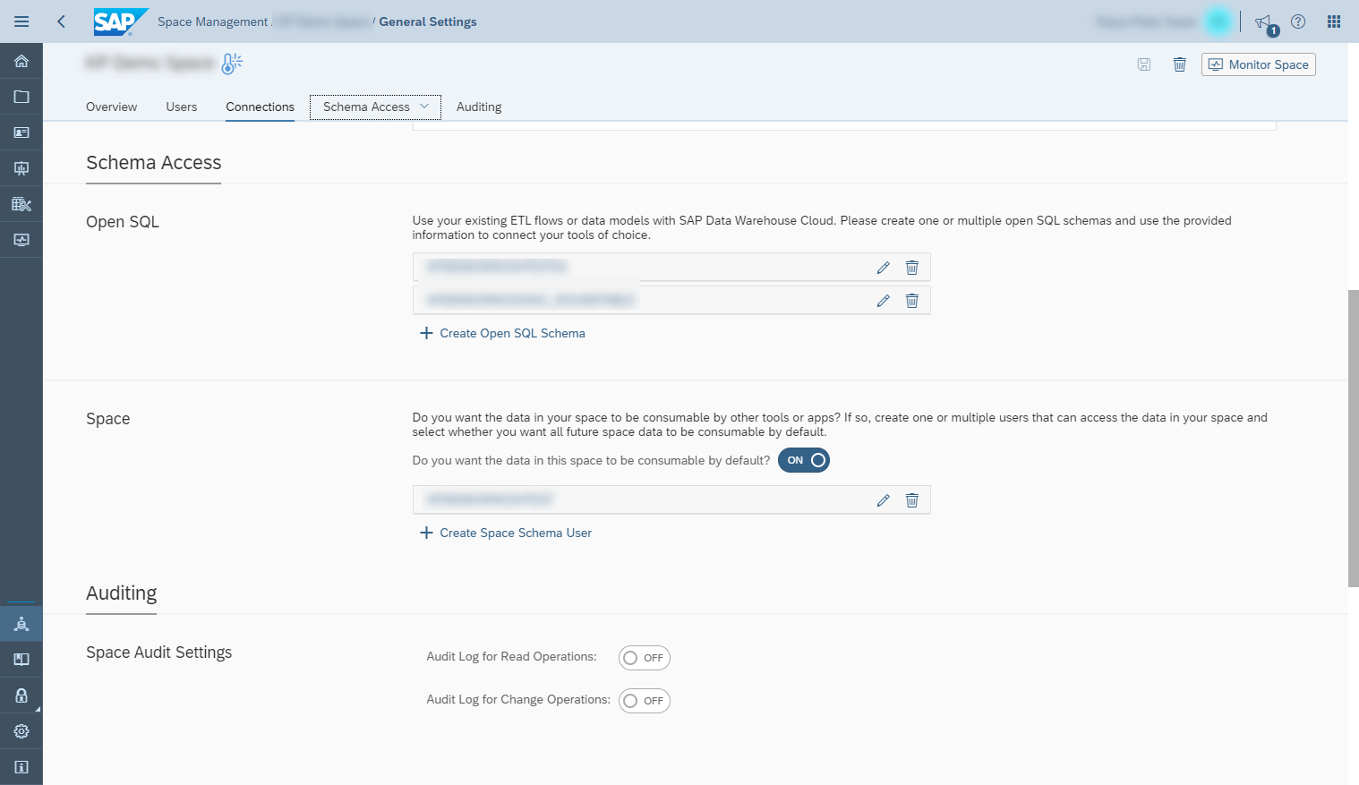
Data Sources & Ingestion: Open SQL Schema
Governance Services
Data Sources & Ingestion
Repository Services
Data Modeling Services
Business Modeling Service
Security Services
Consumption & Business Content
SQL endpoint to dedicated database schema
Connect via any 3rd party SQL client
Usage of any SAP HANA SQL capability
Create views, tables
Define stored procedures
Consume data models from your space in the Open SQL Schema

Slide 12

Data Modeling Services – Overview
Governance Services
Data Sources & Ingestion
Repository Services
Data Modeling Services
Business Modeling Service
Security Services
Consumption & Business Content
Data Builder: Entity-Relationship Modeler, Tables, and Views
Data Transformation and Harmonization
ELT / ETL Process Support*
Data Flow*
Scheduling functionality*
Process Monitoring
Data Auditing Functionalities (Governed data changes)
Q3 Beta, Q4 GA
Data models help you to provide a trusted self-service data warehouse environment in your organization. Models are prepared, governed, and secured by system administrators, defining how to access the data. The layer provides tools to combine and harmonize data in a unified, standardized way. Data changes are monitored and access to data sources can be handled in a managed manner.

Slide 13
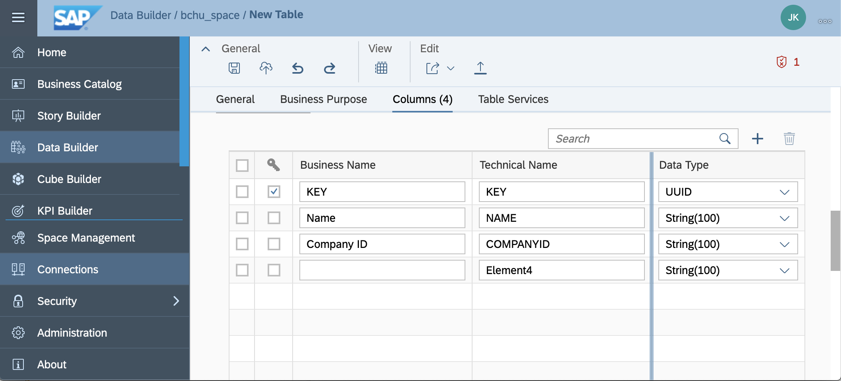
Data Modeling Services: Table
Governance Services
Data Sources & Ingestion
Repository Services
Data Modeling Services
Business Modeling Service
Security Services
Consumption & Business Content
Define general properties like technical and business name
Provide business purposes for easy re-use and search capabilities
Customize field list by adjusting descriptions, field names, data types and semantics

Slide 14
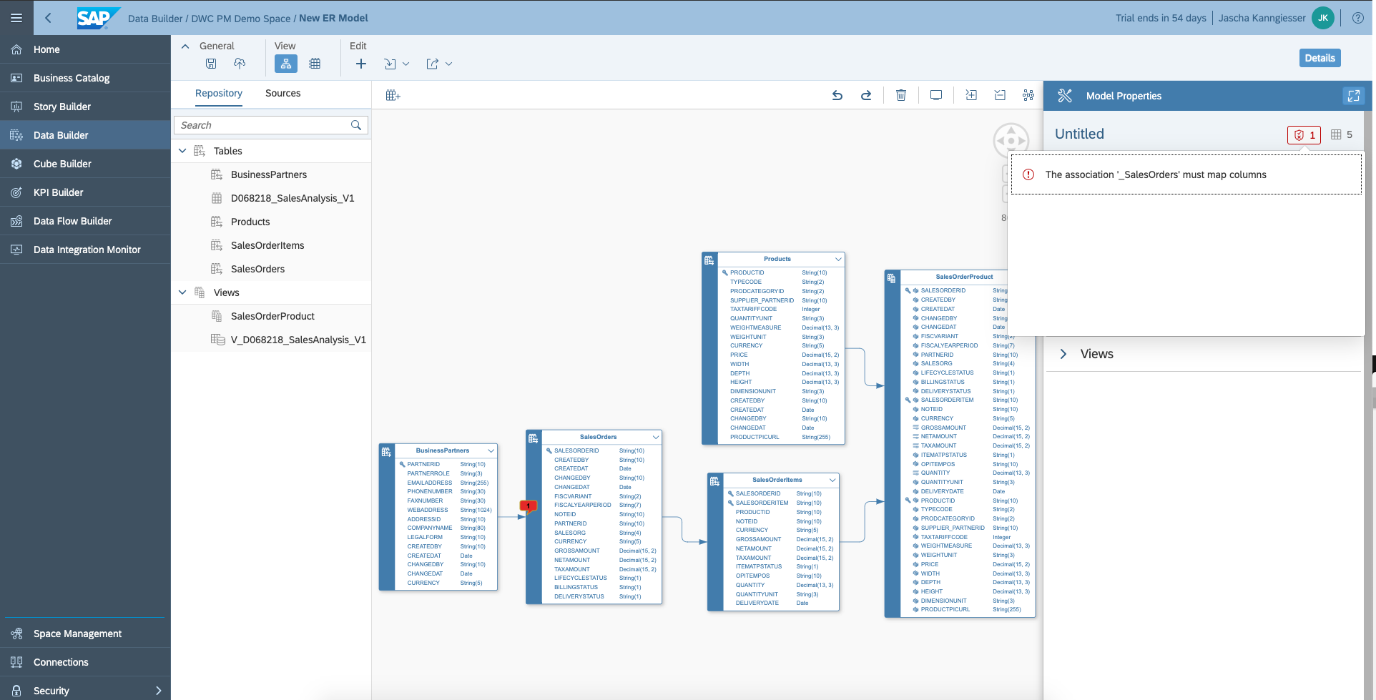
Data Modeling Services: Entity-Relationship Modeler
Governance Services
Data Sources & Ingestion
Repository Services
Data Modeling Services
Business Modeling Service
Security Services
Consumption & Business Content
Definition of entity-relationship models
Design physical or remote database models
Reverse model engineering
Re-use existing entities (table, view) from Data Builder
Add new entities on-the-fly
In-editor real time data preview
Model Import / Export

Slide 15
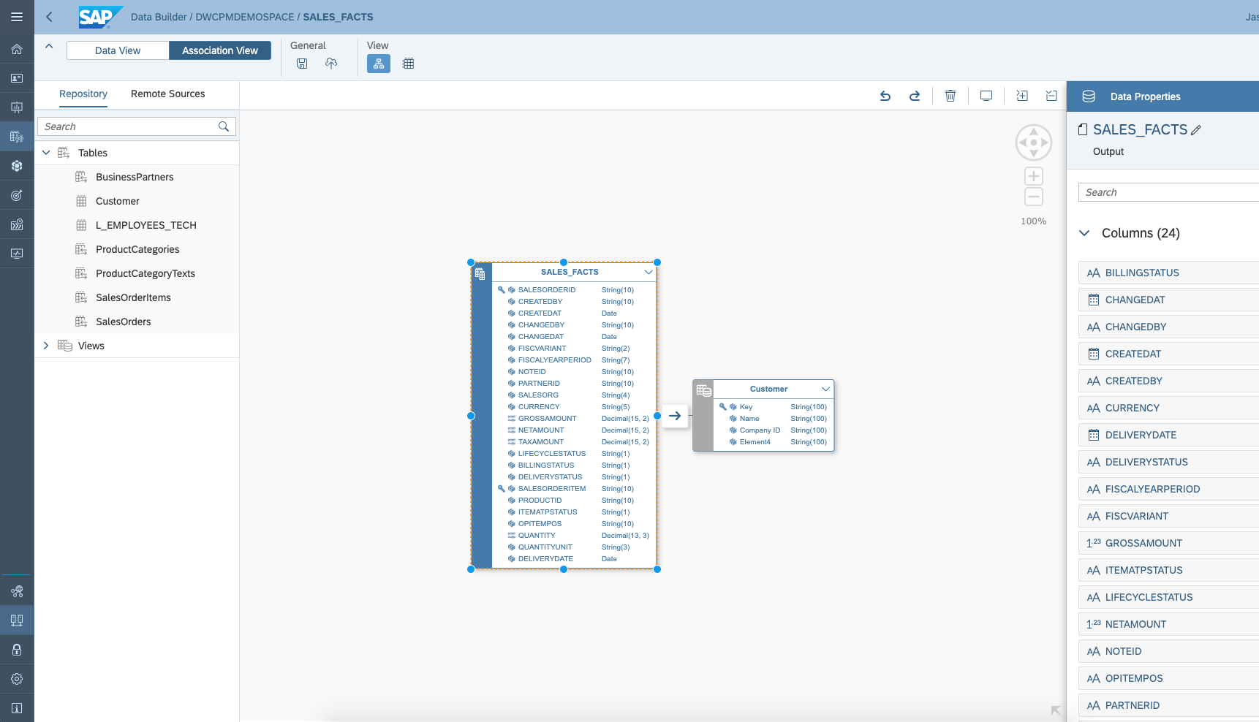
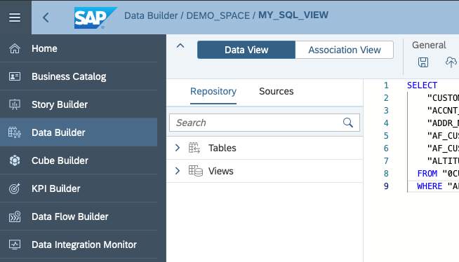
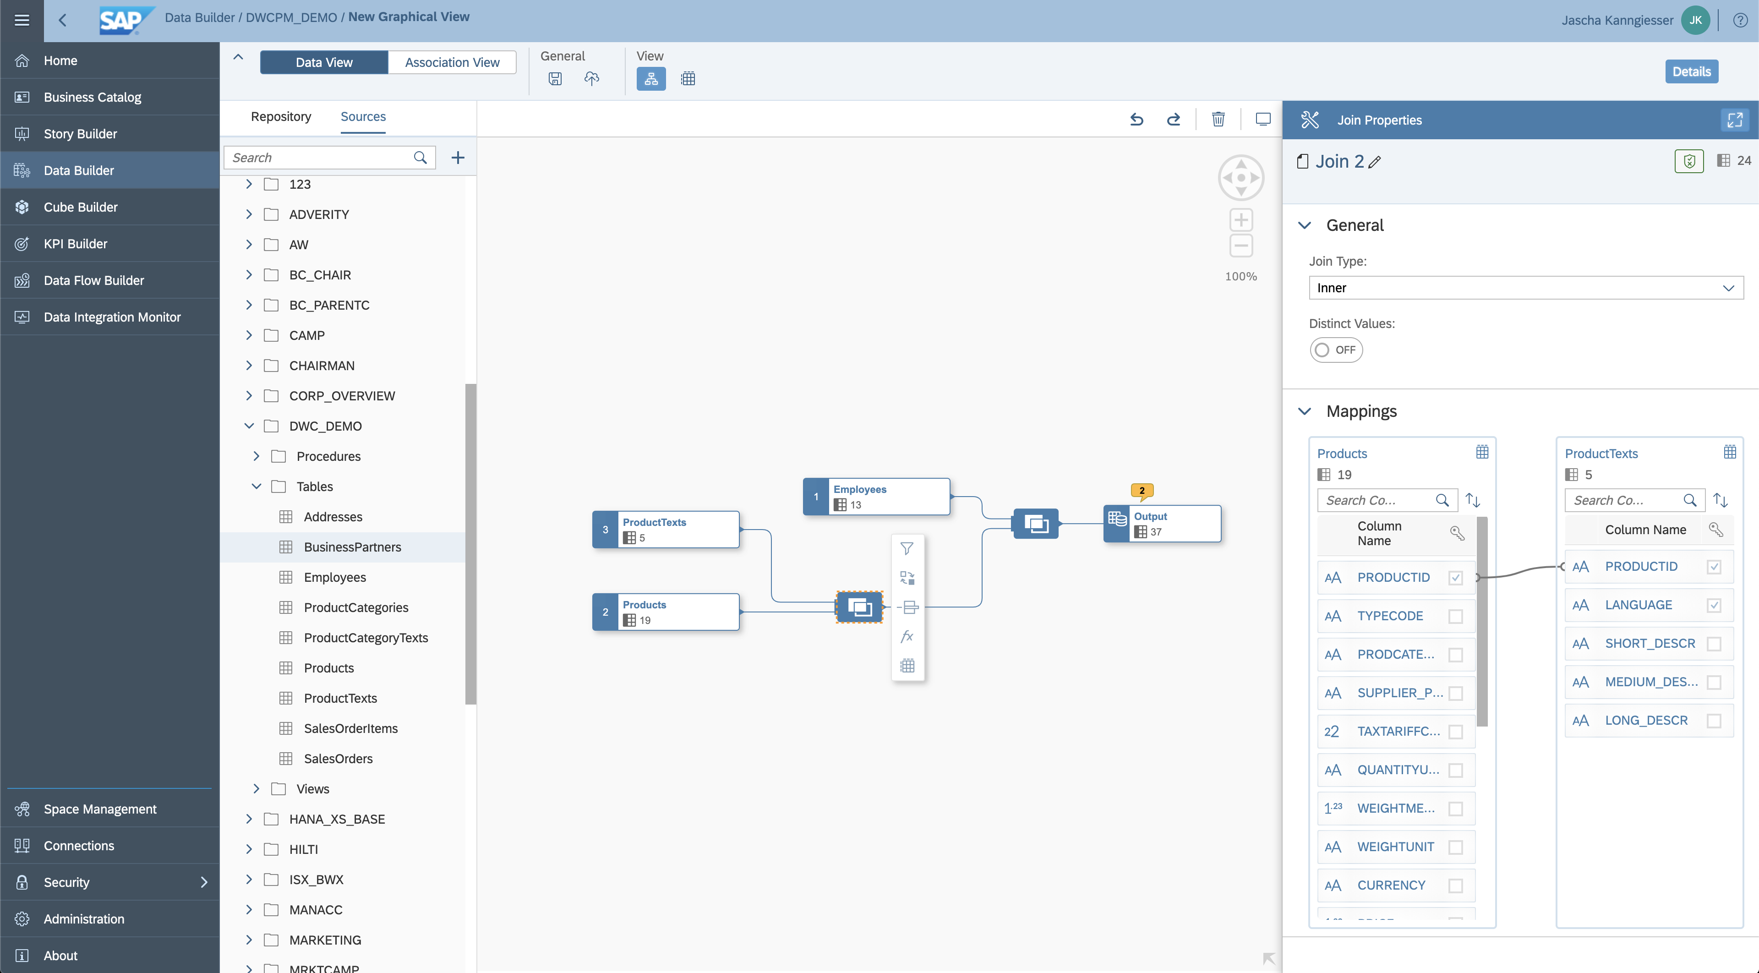
Data Modeling Services: View
Governance Services
Data Sources & Ingestion
Repository Services
Data Modeling Services
Business Modeling Service
Security Services
Consumption & Business Content
Graphical or script-based editor
Define views on top of remote, replicated data sources, or tables
Define unions and joins, rename and remove columns, add calculations and filters
Create Analytical Datasets, Dimensions or Relational Datasets
Create Parent-Child or Level-based hierarchies in Dimension views
Define measures & attributes in Analytical Datasets
In the Graphical View Builder, you can compute and display the corresponding SQL Statement.

Slide 16
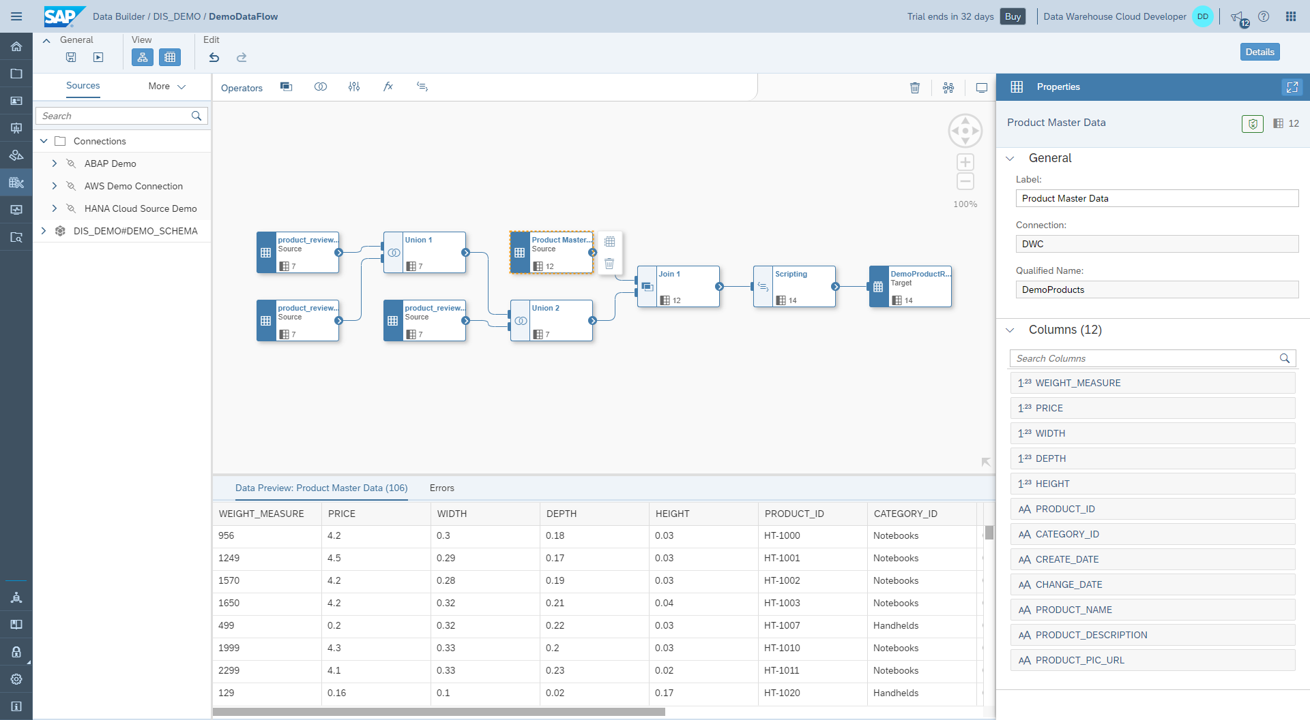
Data Modeling Services: Data Flow – Overview
Governance Services
Data Sources & Ingestion
Repository Services
Data Modeling Services
Business Modeling Service
Security Services
Consumption & Business Content
Q3 Beta, Q4 GA
Data integration from various unstructured and structured data sources
New and easy to use data flow based modeling experience for ETL requirements
Load and combine structured and unstructured data from different data sources (SAP and non-SAP) like file storages, DBMS or SAP S/4HANA
Standard transformation capabilities and scripting for advanced requirements

Slide 17

Business Modeling Services: Overview
Governance Services
Data Sources & Ingestion
Repository Services
Data Modeling Services
Business Modeling Service
Security Services
Consumption & Business Content
Q3 Controlled Availability, Q4 GA
Business user self service to early explore, validate and model their business scenarios in Data Warehouse Cloud
Fosters a non-disruptive environment for business scenarios by being independent from changes in the data layer
Bringing business users and technical experts on one common ground
Demand-Driven modeling using a top down approach*
Business Catalog
The business modeling services offer a clear separation between semantic modeling (what) and data modeling (how). It enables business users to define & model their business scenario without an early involvement of technical experts by abstracting from underlying data models. Giving them the chance to build rapid PoCs and turn those into productive use cases.

Slide 18
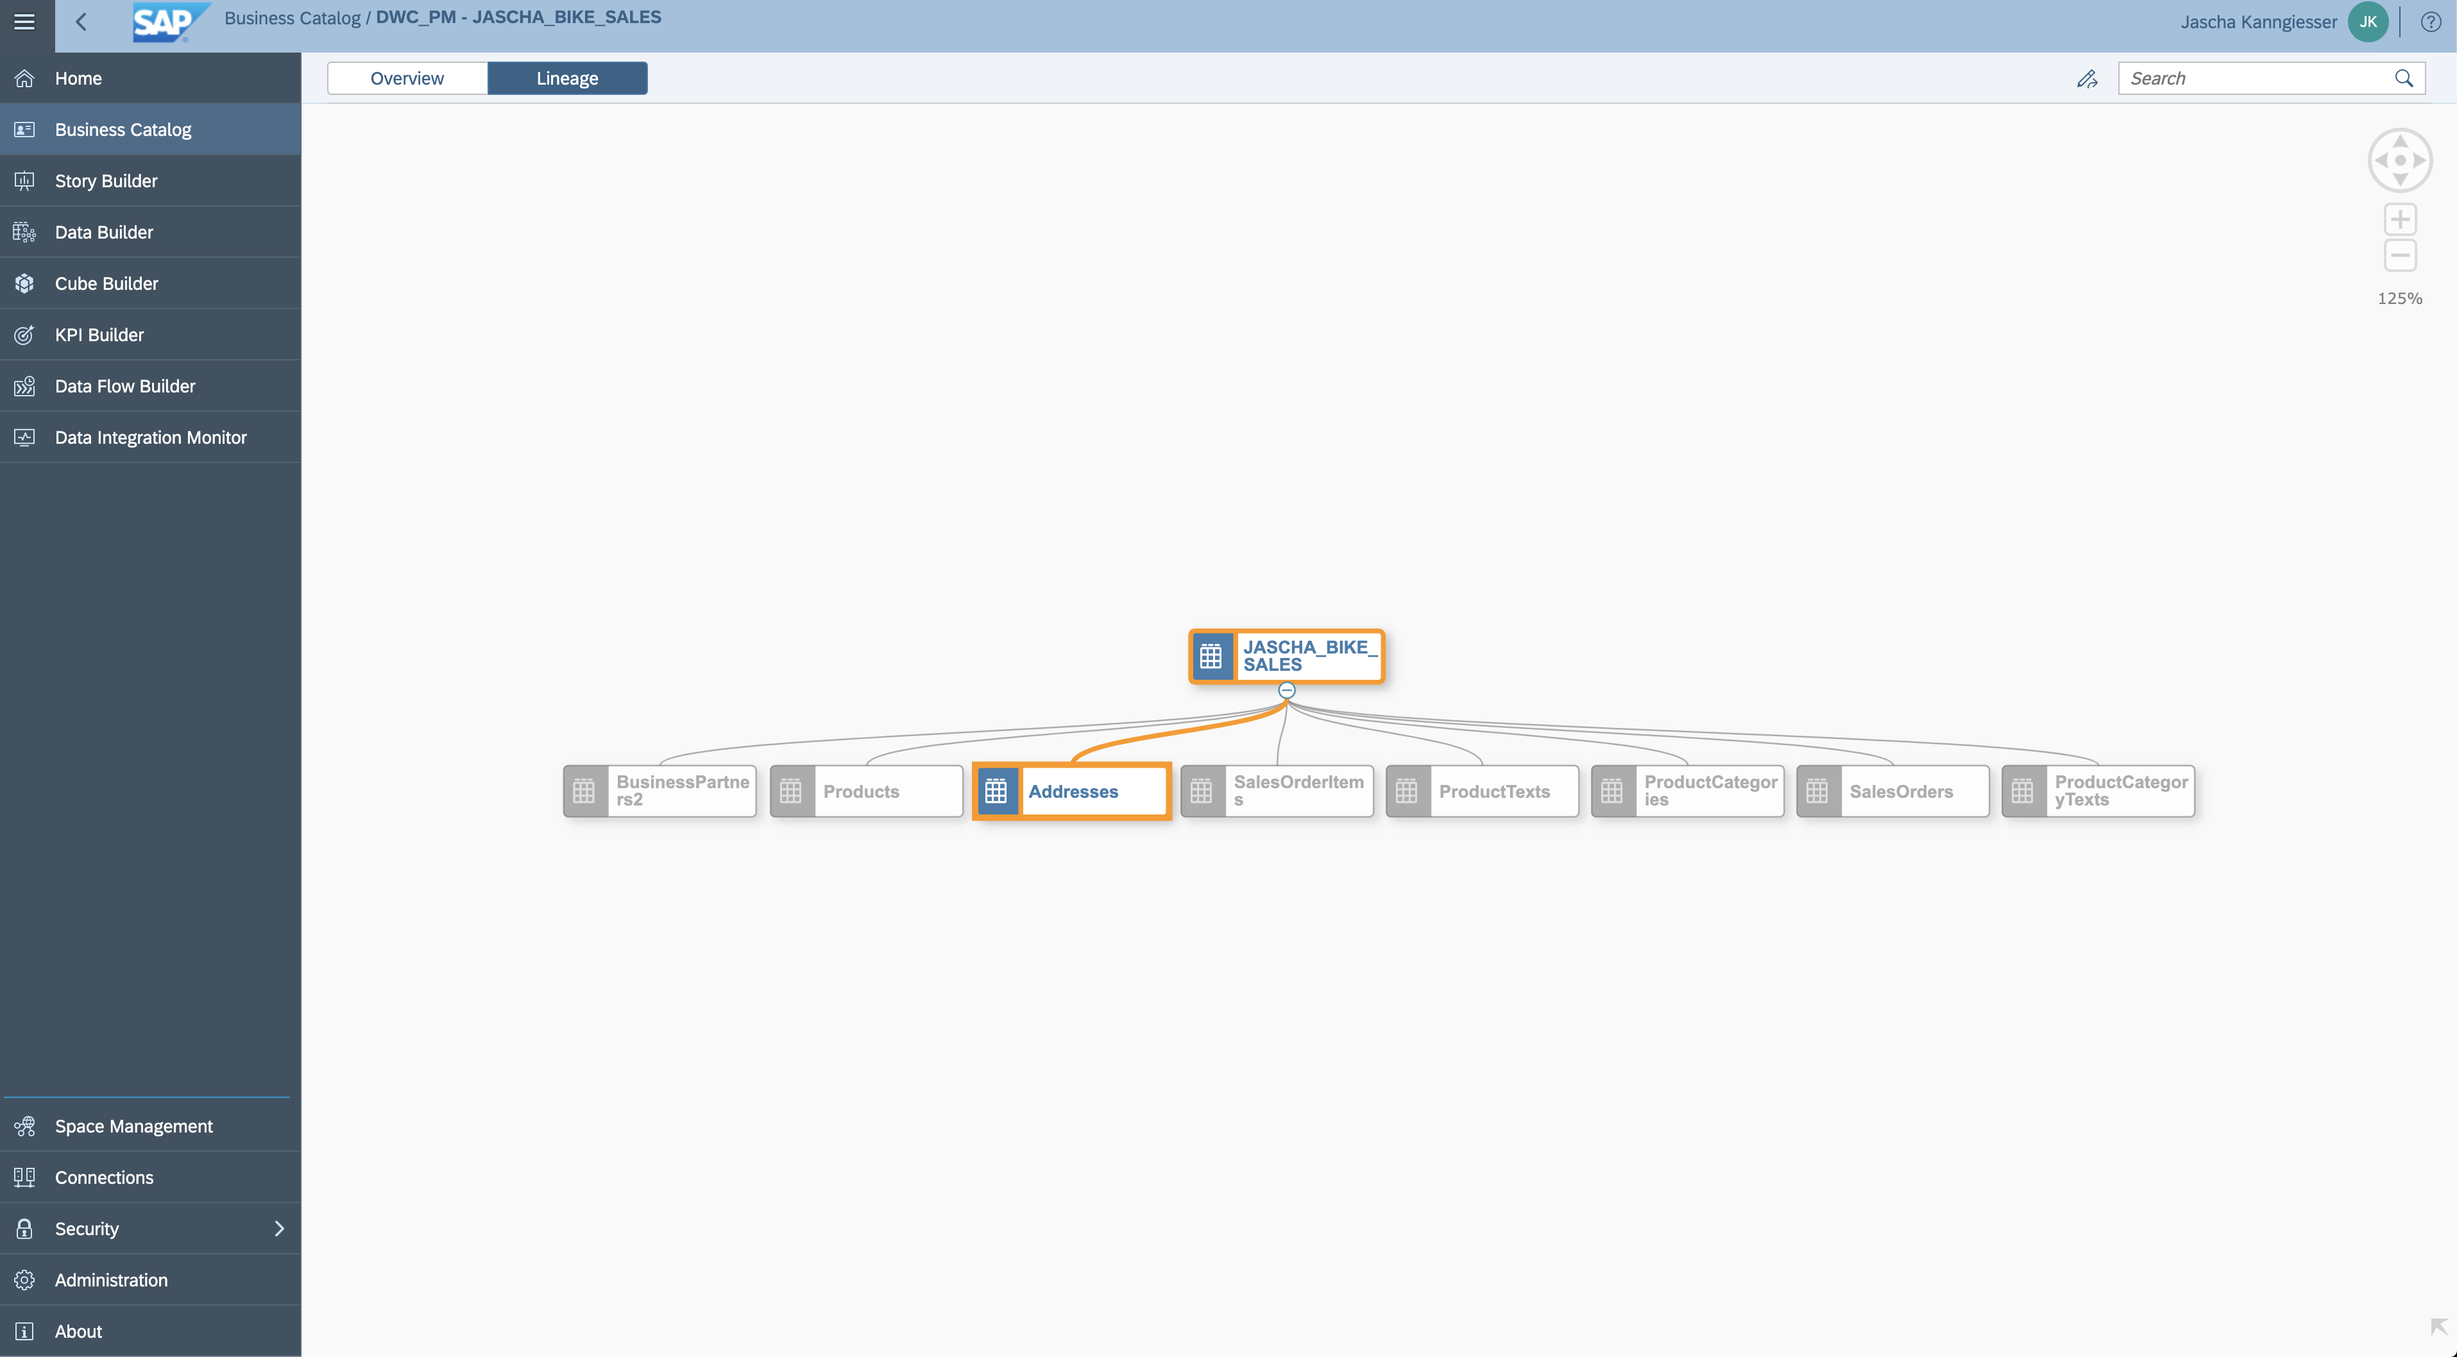
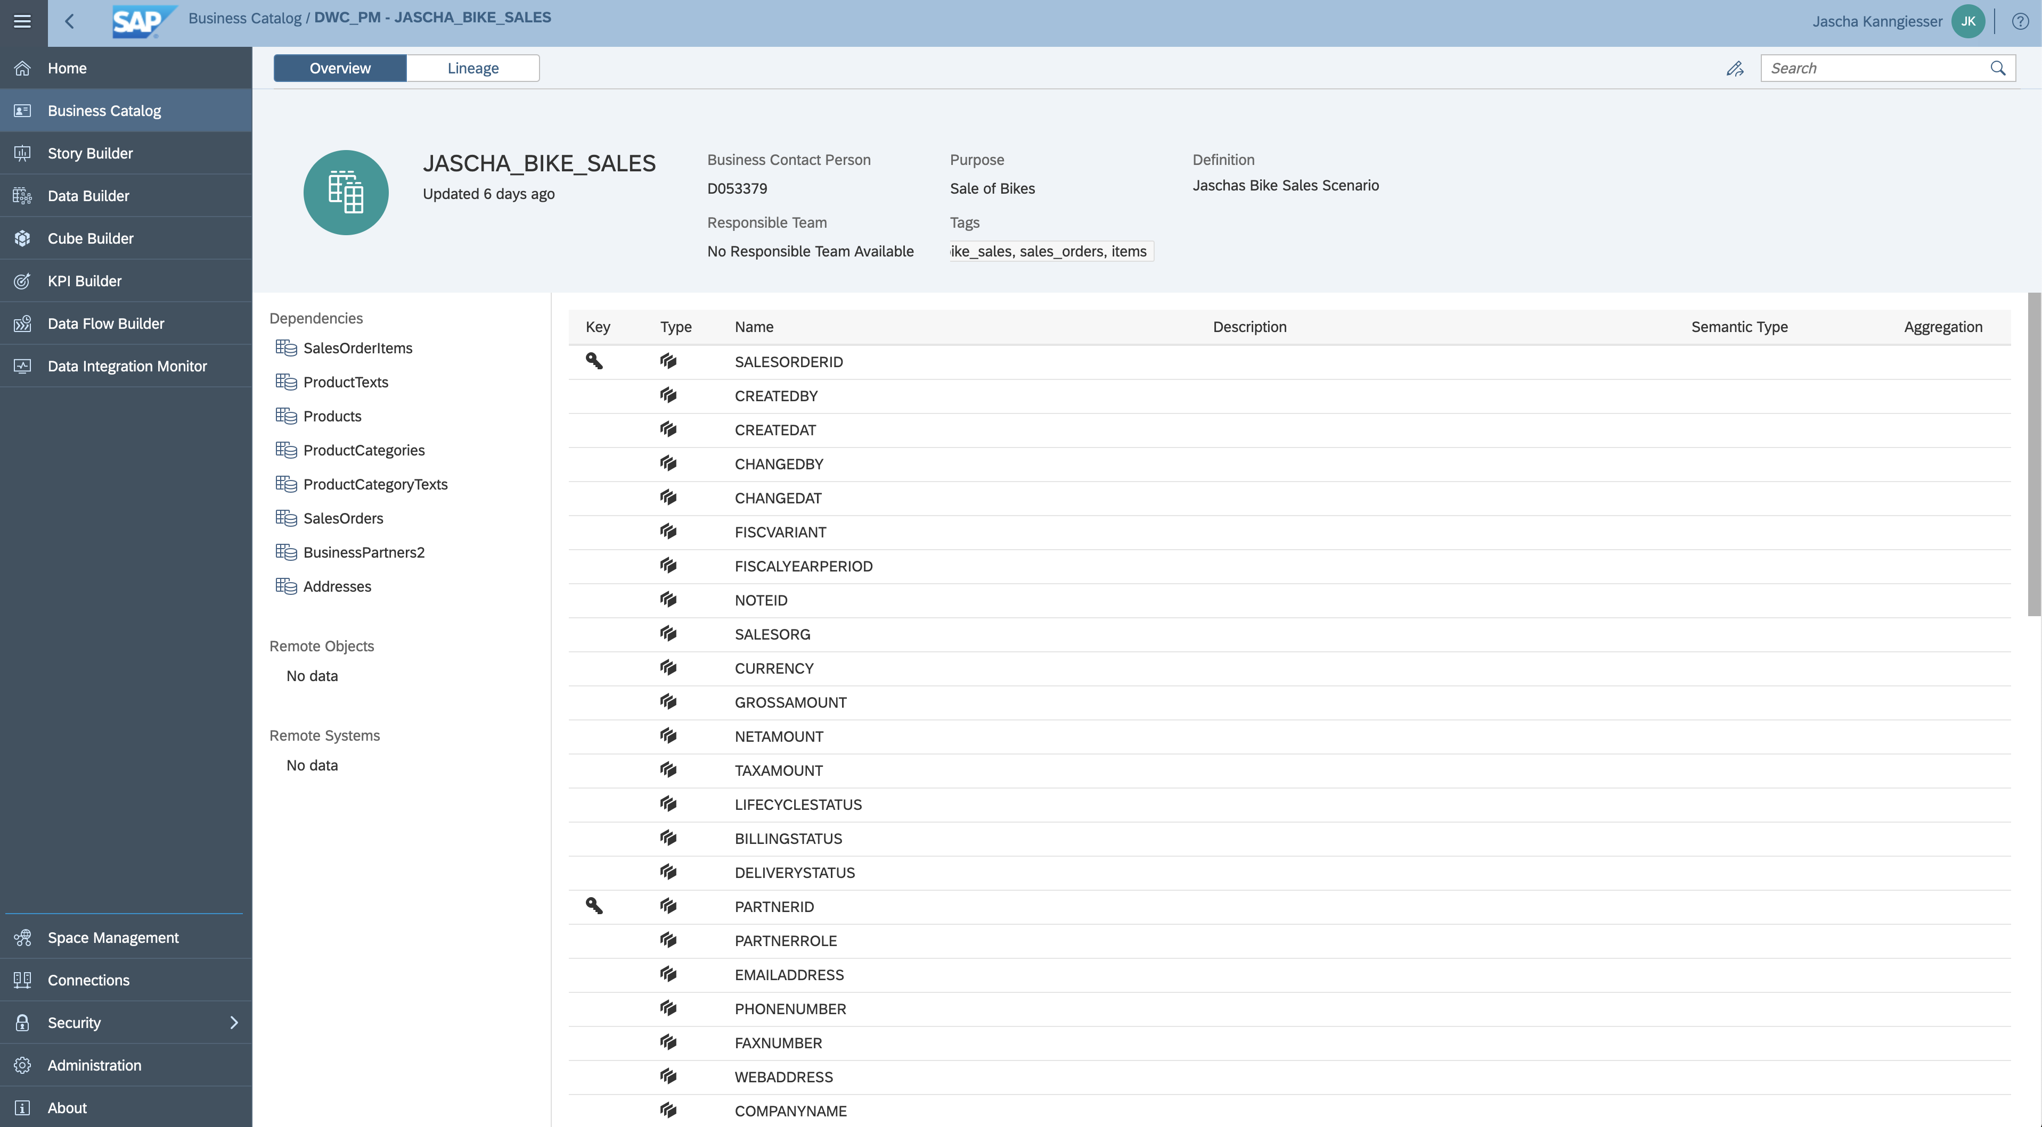
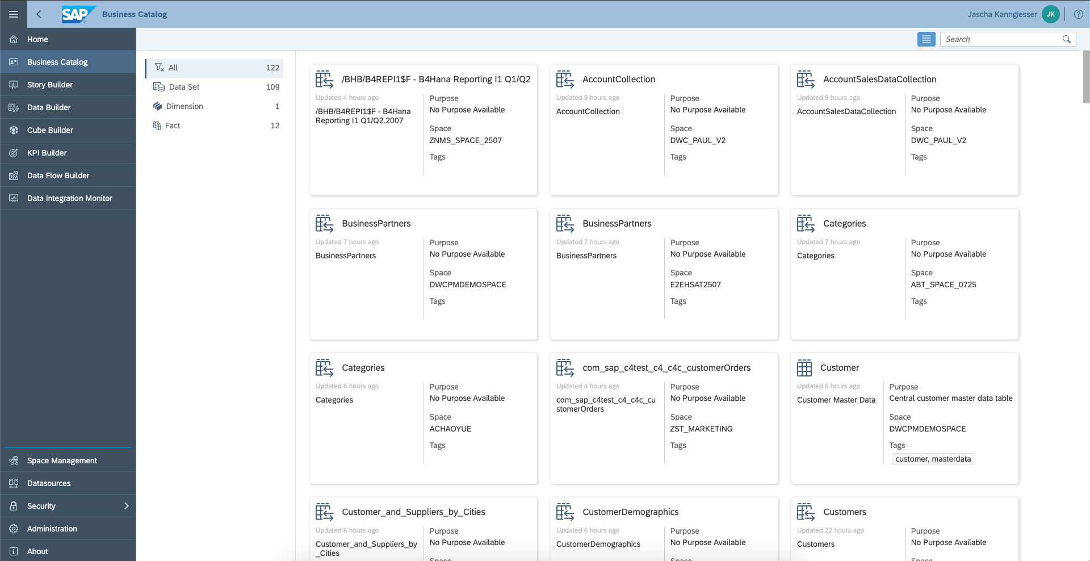
Business Modeling Services: Business Catalog
Governance Services
Data Sources & Ingestion
Repository Services
Data Modeling Services
Business Modeling Service
Security Services
Consumption & Business Content
One entry point for all objects from Business and Data Layer
Start all modeling activities from one place
Get an instant overview on all available objects*
Intuitive Fuzzy Search Function
Sorting, Filtering, Grouping
Favorites list
For spaces, tags, business purpose
Governance and Modeling Life Cycle Management
Artifacts comparison*
Data lineage function
Approval and review workflows*

Slide 19

Consumption – Overview
Governance Services
Data Sources & Ingestion
Repository Services
Data Modeling Services
Business Modeling Service
Security Services
Consumption & Business Content
SAP Analytics Cloud Access to SAP Data Warehouse Cloud Data via SAC - DWC live connection
SAP Analytics Cloud Story Builder
SAP Analytics Cloud Analytics Designer
SAP Analytics Cloud Data Explorer
SQL Interface
Connect any SAP Analytics Cloud system to any SAP Data Warehouse system or consume available data models with your SQL tool of choice.

Slide 20




Business Content – Outlook
Governance Services
Data Sources & Ingestion
Repository Services
Data Modeling Services
Business Modeling Service
Security Services
Consumption & Business Content
Semantic Objects like Dimensions, Hierarchies, Facts, and KPIs to build the Semantic Layer*
Pre-defined connectors to SAP data sources for live-access and data replication*
Out-of-box integration with SAP Analytics Cloud
Use Content Network for Lifecycle Management and Business Content Import (SAP and partner)
SAP LoB and Industry Content
Partner Content
Continuous delivery of Line of Business and Industries content packages to support the Intelligent Enterprise. Imported content can be adapted and extended.*
Business Catalog
SAP Analytics Cloud

Slide 21
Business Content Packages *
Governance Services
Data Sources & Ingestion
Repository Services
Data Modeling Services
Business Modeling Service
Security Services
Consumption & Business Content
SAP Content
Retail – Sales Analysis based on SAP Consumer Intelligence (Q2/2020)
CFO Dashboard: financial information, personnel costs and related Human Resource information will be integrated to provide a comprehensive view on the cost structure. (H2/2020)
Partner Content (Q2/2020) also listed AppCenter
Adverity GmbH – Marketing Analytics for SAP Data Warehouse Cloud
CubeServ: Procurement Cockpit for SAP Data Warehouse Cloud
datazeit: E-Commerce Insights in SAP Data Warehouse Cloud
Inspired Intellect: Optimizing Order Fulfillment with Machine Learning
KPC: HR Cockpit - Automatic Attendance Tracker
PwC: Sales Insights – One place, all your sales data
Rizing: Lyra Integrated Capacity Planning
s-peers AG: Financial Reporting for SAP Business One
Westernacher: EWM Insights on Data Warehouse Cloud

Slide 22
SAP Data Warehouse Cloud Business Layer Modeling
Q3 controlled availability, late Q3 GA

Slide 23






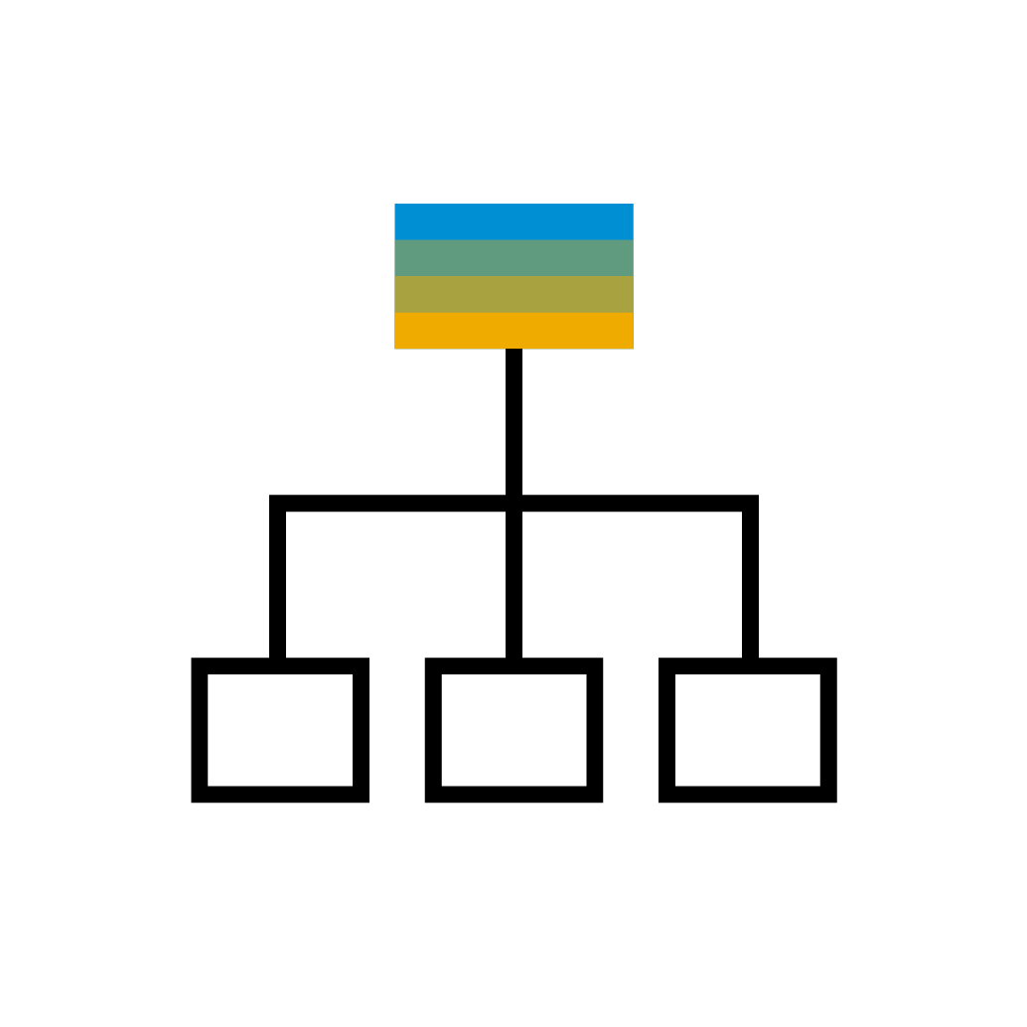



SAP Data Warehouse Cloud Business Layer Modeling
Business representation within the enterprise
Allows business users to model in common business language and terms
Encapsulates domain knowledge into business entities
Specifies associations between business entities
Independent of the underlying data layer
→ The business modeling lays the foundation for consumption.
Pipeline coverage
Open pipeline
Business Layer
Time
Product
Sales pipeline
Sales quota
Product hierarchy
Auth. scenario Product responsibility
remap
Material view
Sales pipeline Mock Data
Sales quota view
Time view
map
Sales pipeline view
Data Layer
map
map
map

Slide 24
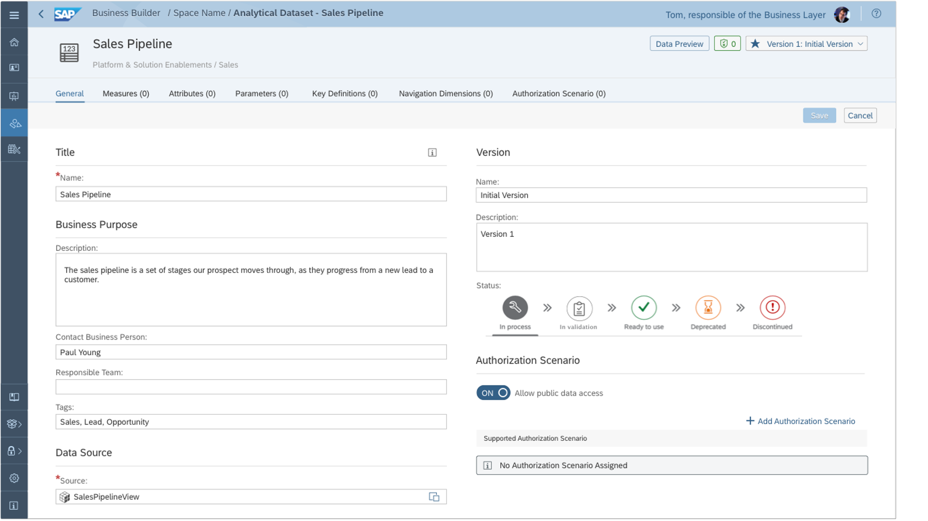
SAP Data Warehouse Cloud Business Entities
Encapsulate domain knowledge into business entities
By mapping complex data models to be represented in business terms
By specifying contextualized relationships between business entities using associations
By creating simple calculated and restricted measures
Create independence of the underlying data layer
By stabilizing usage through versioning for business entities

Slide 25

SAP Data Warehouse Cloud Consumption Model
Pick up the required business entities to serve a concrete business need
Utilize business layer associations to get system support on "auto-wiring" the business entities
Enrich with additional calculations
Run advanced data preview with filtering, sorting, and parameterization* capabilities to validate the modeled business logic
Deploy and publish the consumption model to any target client (SAP Analytics Cloud, 3rd party through SQL, ...)
Pipeline coverage
Deploy the consumption model
Open pipeline
Product
Sales pipeline
Sales quota
Time
Product hierarchy
Auth. scenario Product responsibility
map
map
remap
map
map
Material view
Sales pipeline Mock Data
Sales quota view
Time view
Sales pipeline view

Slide 26
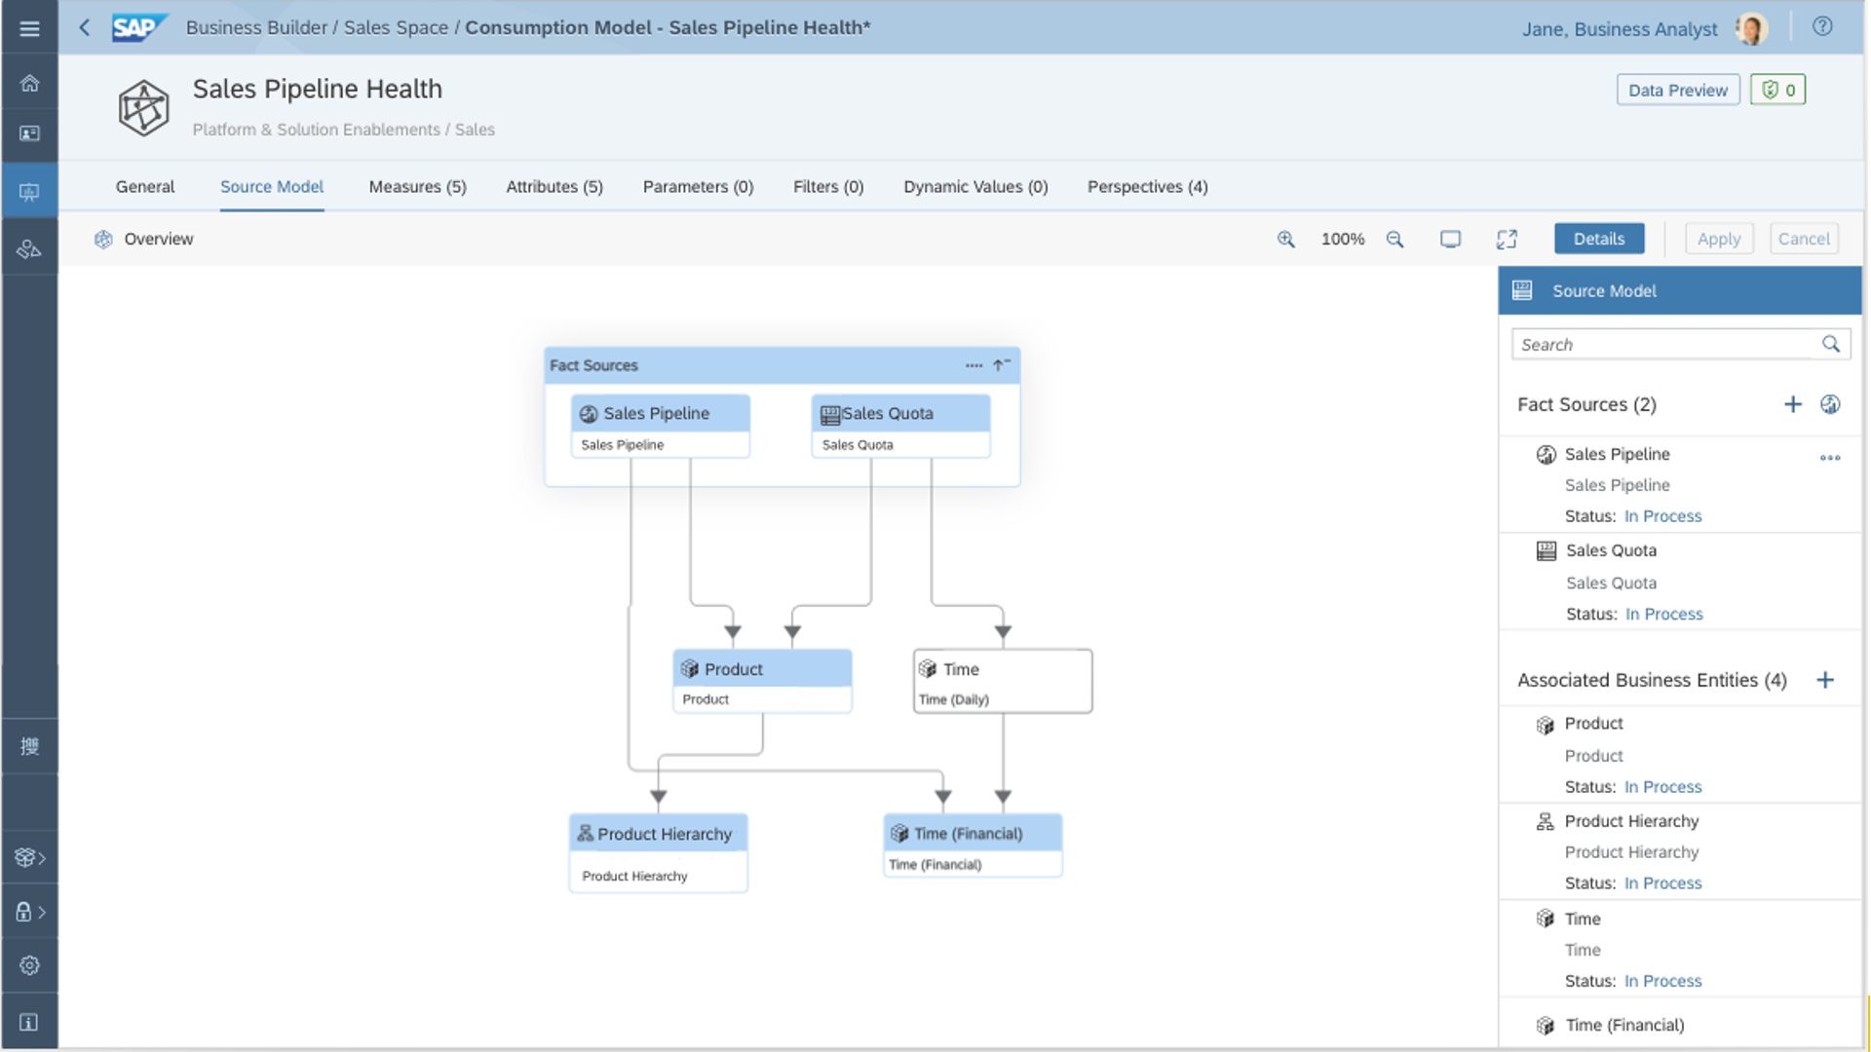
SAP Data Warehouse Cloud Fact Modeling
Allow stacking and reuse of complex yet generic business logic by utilizing fact models
Create simple calculated and restricted measures to depict KPIs
Depict specific use cases using consumption models
Reuse existing fact models and business entities
No reinventing and no duplication of business logic
Foster early exploration and validation utilizing the data preview

Slide 27

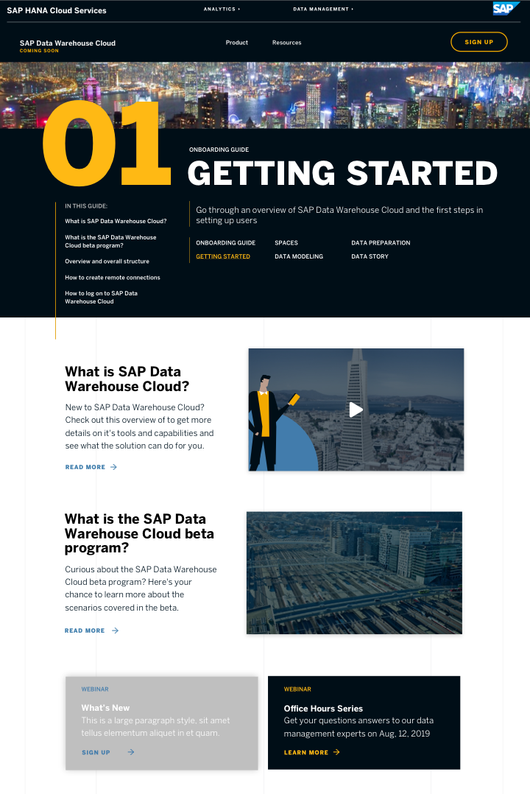
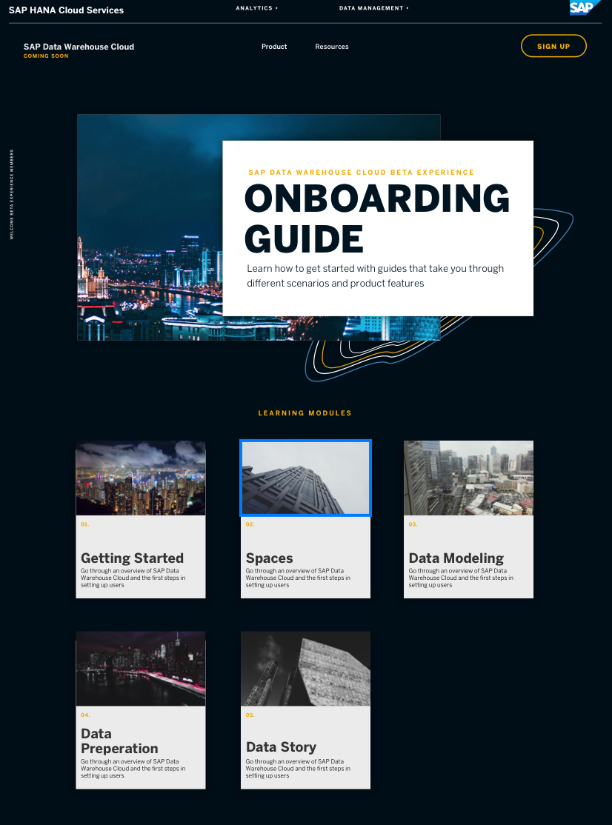
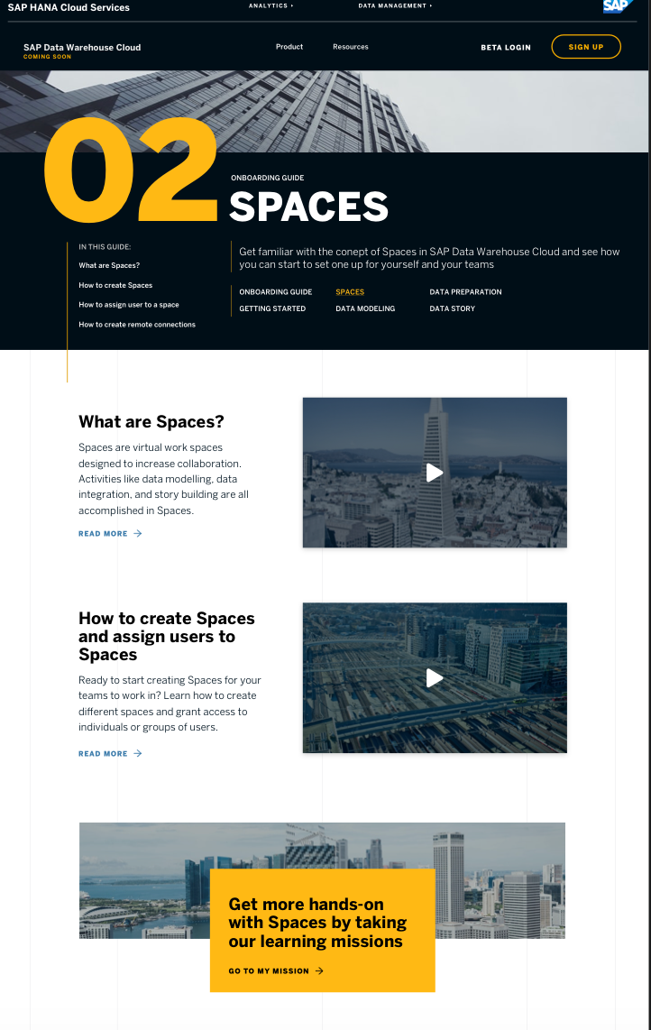

More information
Find out more at www.sapdatawarehouse.cloud
Onboarding Guide
Learning academy
Blogs
SAP Help Portal – Documentation
Calculator
SAP Road Map Explorer
SAP Community
Sample content on GitHub
Provide your feedback:

Slide 28
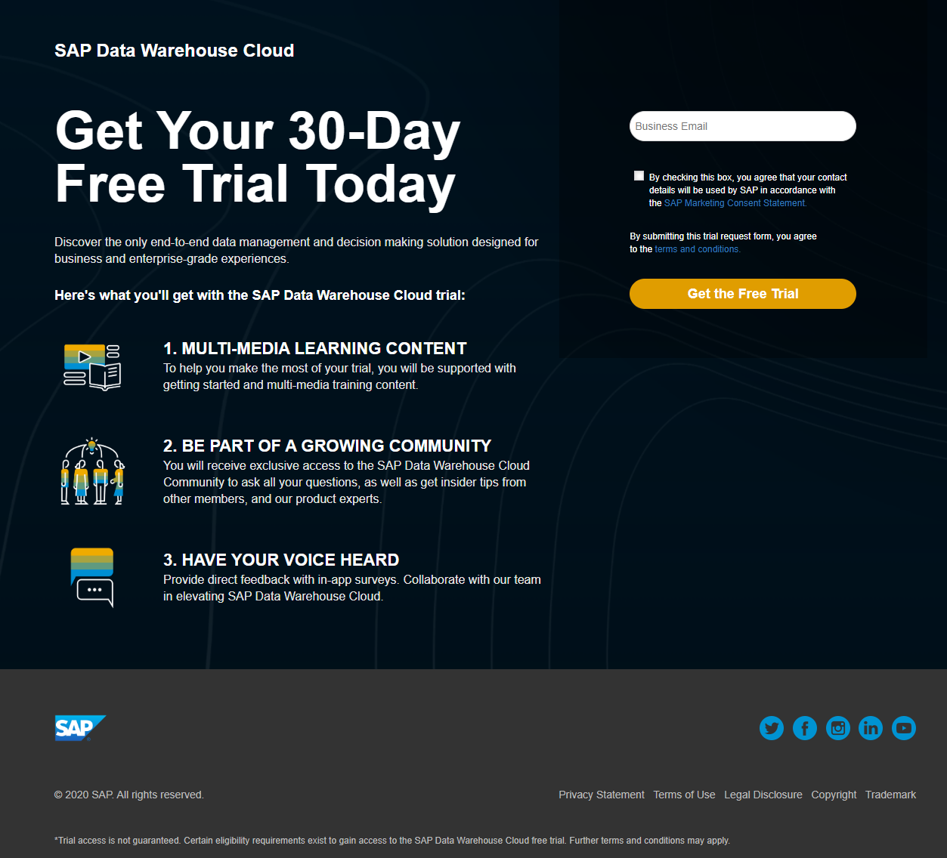

Get your 30-Day free trial today
https://info.sapdigital.com/sap-data-warehouse-cloud-trial.html

Slide 29

More information
Related SAP TechEd sessions
ANA115 – SAP Data Warehouse Cloud: Open for Integration ANA116 – Consume Data from SAP Data Warehouse Cloud with Third-Party BI Tools ANA365 – Data Integration and Data Flow Modeling with SAP Data Warehouse Cloud ANA366 – Agile Business and Data Layer Modeling with SAP Data Warehouse Cloud ANA901 – Spaces: A Unique Concept to Better Manage Your Data Consumption ANA106 – SAP Analytics Cloud and SAP Data Warehouse Cloud: Best of Both Worlds ANA114 – Get the Best of SAP Analytics Cloud and SAP Data Warehouse Cloud
Public SAP Web sites
SAP Community: https://community.sap.com/topics/data-intelligence SAP products: https://www.sap.com/products/data-intelligence.html

Slide 30

More Information about SAP Data Warehouse Cloud
Find out more at www.sapdatawarehouse.cloud
Onboarding Guide
Learning Academy
Blogs
SAP Help Documentation
Calculator
SAP Road Map Explorer
SAP Community
Sample Content on GitHub
Provide your feedback:

Slide 31

Get your 30-Day Free Trial Today
https://info.sapdigital.com/sap-data-warehouse-cloud-trial.html

Slide 32
More information
Related SAP TechEd sessions
ANA361 - Integrating SAP Analytics Cloud and SAP Data Warehouse Cloud (Workshop) ANA832 – Roadmap – Strategy of SAP Analytics Cloud ST111 – Realizing the Data Superpower (Strategy Talk) ANA108 – SAP Data Warehouse Cloud Overview
Public SAP Web sites
SAP Community: www.sap.com/community SAP products: www.sap.com/products

Slide 33
Thanks for attending this session.
Contact for further topic inquiries
Ingo Hilgefort
Global Product Evangelist
Ingo.Hilgefort@sap.com
Amogh Kulkarni
Product Management
amogh.kulkarni@sap.com

